Slide 1
LCC_CSGP Protocol

Slide 2
App-Agent communication: Submitting and saving exercise result
MyWelcome app#1
MyWelcome app#m
App-Logic
. . .
App-Logic
Steps:
App-logic sends the exercise results to agent
Agent calculates the course progress level (CPL) by averaging all of the lesson progress levels that were submitted so far.
Agent saves the CPL and submitted scores.
App-Logic
App-Logic
App-Logic Interface
App-Logic Interface
1.1 Send scores to agent#1
1.m Send scores to agent#m
Info package: Reading: …
Writing : …
Grammar : …
Vocabulary : …
Lesson Progress Level : …
Info package: Reading: …
Writing : …
Grammar : …
Vocabulary : …
Lesson Progress Level : …
Agent#1
Agent#m
2.1 Compute Course Progress Level
. . .
2.m Compute Course Progress Level (CPL)
Agent Interface
Agent Interface
LAKR#1
3.1 Save CPL and scores to LAKR
LAKR#1
3.m Save CPL and scores to LAKR

Slide 3
LCC Protocol: Teacher requests grouping proposal
Phase 1.a Teacher selects a list of agents who belong to the same classroom
WPM
Teacher Panel
Info package
Agents:
Agent_1 - active, *cl3
.
Agent_10 - active, cl3
Agent_11 - inactive, cl3
.
Agent_m - inactive. cl3
Phase 1.c.1
Form groups
Phase 1.c.m
Form groups
Phase 1.b. WPM reactivates inactive agents
Info package Form groups with:
*Agent_1,
.
Agent_m
Info package Form groups with:
*Agent_1,
.
Agent_m
WPM Interface
Info package
Agents:
Agent_11,
.
Agent_m
WAR
Agent#1
Agent#m
Agent#n
. . .
. . .
Agent Interface
Agent Interface
Agent Interface
Steps:
Phase 1.a Teacher selects a list of TCNs who belong to the same classroom, via Teacher panel in WPM
Phase 1.b WPM reactivates inactive agents of TCNs such that all agents in the list are active before next step.
Phase 1.c WPM selects (randomly or based on resource availability of the agent) an agent as dedicated agent. WPM attaches dedicated agent and list of agents information to a signal and sends it to each agent to inform them to start coordination.
Communication:
Phase 1.c - m
*Agent_1: indicates that agent_1 is selected as dedicated agent
*cl3: is classroom name - classroom 3

Slide 4
LCC Protocol : Agents share info
Received signal to start coordination
Agent#1
Phase 2.a.10 Send info to dedicated agent
Phase 2.a.m Send info to dedicated agent
Not received any signal
to start coordination
Agent Interface
Phase 2.b Generate and filter out CSs which violate system constraints
Phase 2.d Evaluate coalitions based on individual preferences
Agent#n
Info package:
Gender: …
Nationality: …
CPL: …
Attendance:…
Phase 2.e.10 Send coalition values to dedicated agent
Phase 2.e.m Send coalition values to dedicated agent
Info package:
Gender: …
Nationality: …
CPL: …
Attendance:…
Received signal to start coordination
Agent Interface
Info package
coalition₁₀#i - x
.
coalition₁₀#j - y
Info package
coalition_{m}#i - x
.
coalition_{m}#j - y
Received signal to start coordination
Agent#10
Phase 2.c.10 Send complete info to agent#10
. . .
Phase 2.c.m Send complete info to agent#m
Agent#m
Agent Interface
Info package
Agent#1 info
.
Agent#m info
- - - - - - - - - -
coalition₁₀#i
.
coalition₁₀#j
Info package
Agent#1 info
.
Agent#m info
- - - - - - - - - -
coalition_{m}#i
.
coalition_{m}#j
Agent Interface
Phase 2.d Evaluate coalitions based on individual preferences
Phase 2.d Evaluate coalitions based on individual preferences
Steps:
Phase 2.a. Each agent receives the signal and sends its personal info to dedicated agent
Phase 2.b. Dedicated agent generates all CSs and filters the ones which violate the system constraints such as cluster cardinality. To do so, filtering functions (illustrated in the last slides) are used.
Phase 2.c. Dedicated agent broadcasts the complete info (which is collected in phase2.a) and a set of coalitions where the receiver agent is a member.
Phase 2.d. Since each agent has the complete info, they calculate utility values based on their individual preferences which they don’t share with dedicated agent. To do so, they make use of utility function (illustrated in the last slides)
Phase 2.e. Each agent sends the utility values to dedicated agent.
Communication:
Phase 2.a - m-1
Phase 2.c – m-1
Phase 2.e – m-1

Slide 5
LCC Protocol : Agents find solution
Collected all necessary info from agents
Agent#1
Phase 3.b.10 Send CSGP to agent#10
Phase 3.b.m Send CSGP to agent#m
Not participating in the coordination
Agent Interface
Phase 3.a Build the complete CSGP
Phase 3.c Solve the complete CSGP
Agent#n
Agent Interface
Phase 3.d.10 Send the result to agent#10
Phase 3.d.m Send the result to agent#m
Agent#10
Phase 3.d.w Send the result to WPM
Agent#m
Agent Interface
Agent Interface
WPM
Teacher Panel
WPM Interface
Steps:
Phase 3.a. Dedicated agent builds the complete CSGP by computing the coalition value of each potential coalition of a potential CS by making use of the coalition value function (illustrated in the last slides) and coalition structure value function (illustrated in the last slides).
Phase 3.b. (Optional) Broadcast the CSGP to other agents such that they can solve the problem in case dedicated agent is accidentally killed. In this case, WPM signals another agent to become dedicated agent who must approve that it has the CSGP. Otherwise, it requests all agents to do phase 2.d again.
Phase 3.c. Dedicated agent solves the CSGP and finds a single result or a rank list by comparing the CSs based on their values.
Phase 3.d. Dedicated agent sends the result to all agents and WPM. (Optional) WPM might decide to request to kill the agents which were involved in the coordination process.
Communication:
Phase 3.b - m-1
Phase 3.d – m

Slide 6
LCC Protocol : Sending final grouping to agents
Teacher received the grouping proposal from agents
Phase 4.a Teacher either
Selects one from rank list
Modifies the proposal
Approves the proposal
WPM
Teacher Panel
Phase 4.c.1 WPM informs agent#1
Phase 4.c.m WPM informs agent#m
Info package:
Send Grouping result only if the teacher selected from rank list or modified the proposal
Info package:
Send Grouping result only if the teacher selected from rank list or modified the proposal
WPM Interface
Phase 4.b WPM reactivates the inactive agents in the selected grouping
or
or
Steps:
Phase 4.a. After receiving either a proposal or a rank list, teacher can select from the rank list or he/she can modify/approve the proposal which is sent by agents.
Phase 4.b. Once teacher submits, WPM needs to reactivate the inactive agents in the submitted grouping such that all of them can receive the final grouping.
Phase 4.c. WPM informs each agent in the final grouping. The signal should contain either the grouping result or “approved”, respectively, depending on whether teacher selects/modifies or approves.
Info package:
Send Approved only if the teacher approves the proposal
Info package:
Send Approved only if the teacher approves the proposal
Agent#1
Agent#m
Agent#n
. . .
. . .
Communication:
Phase 4.c - m
Agent Interface
Agent Interface
Agent Interface

Slide 7
LCC Protocol : Informing TCN about his/her group
MyWelcome app#1
MyWelcome app#m
App-Logic
App-Logic
App-Logic
. . .
App-Logic
App-Logic Interface
App-Logic Interface
Phase 5.a.1 Send info to app-logic
Phase 5.a.m Send info to app-logic
Info package: Send the name of group of TCN#1
Info package: Send the name of group of TCN#m
Agent#1
Agent#m
Steps:
Phase 5.a. Once an agent receives the final grouping from WPM (Teacher), it only sends the name of the group of TCN to app-logic. Since agents don’t know the identities of other group members, they send the group name such that TCNs can find each other in the classroom.
Phase 5.b. Agents send coordination_ended signal to WPM.
-* Even if the TCN is logged out when agent sends the group name (at phase 5.a), the agent will still continue to phase 5.b. Since agent stores the group name into LAKR, it is not lost. Therefore, TCN will always be able request it from the agent via app-logic.
. . .
Agent Interface
Agent Interface
Phase 5.b.1 Send coordination ended signal to WPM
Phase 5.b.m Send coordination ended signal to WPM
WPM
Teacher Panel
Communication:
Phase 5.a – m
Phase 5.b – m
WPM Interface

Slide 8
Involved Components and Functionalities to be provided
Agent
MyWelcome app_1
MyWelcome app
MyWelcome app_1
WPM
Dispatcher
App-Logic
Teacher Panel
App-Logic
App-Logic
App-Logic Interface
App-Logic Interface
App-Logic Interface
Agent Interface
Dispatcher Interface
WPM Interface
Teacher panel (doesn’t have to be in WPM)
Teacher panel would be able to receive the proposal from agents.
Receiving coordination_ ended signal
Receive exercise result, calculate and store.
Receive start_coordination signal and share info.
Receive personal info and broadcast to others (dedicated agent).
Receive complete personal info from dedicated agent.
Receive coalition value info from other agents, build and broadcast CSGP.
Solve CSGP, broadcast to other agents and share with WPM.
Receive “approved” or grouping from WPM, share with TCN.
Send coordination_ended signal to WPM.
Receive the name of the group of TCN.

Slide 9
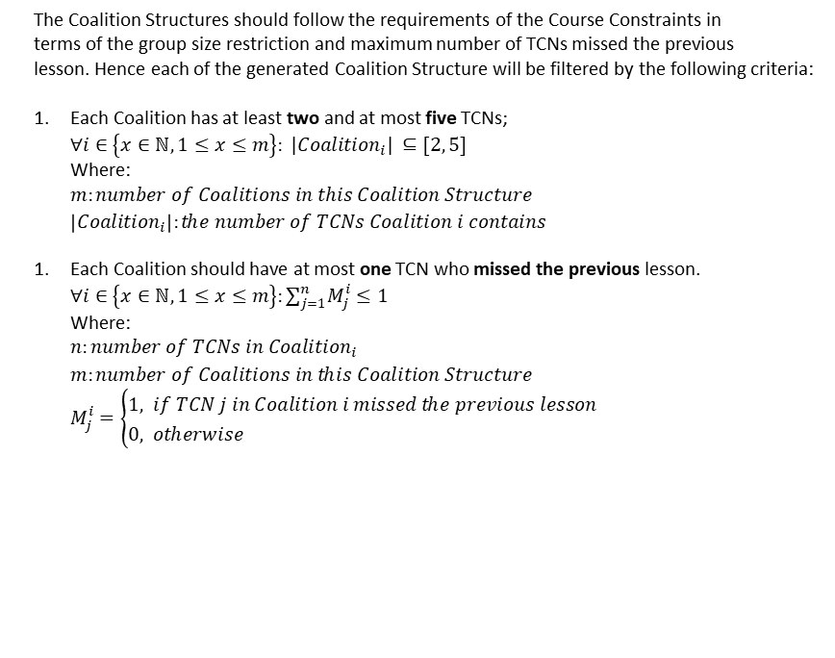
Functions
Filtering functions
The Coalition Structures should follow the requirements of the Course Constraints in terms of the group size restriction and maximum number of TCNs missed the previous lesson. Hence each of the generated Coalition Structure will be filtered by the following criteria:
Each Coalition has at least two and at most five TCNs; $∀i∈\left\{x∈ℕ, 1≤x≤m\right\}: |{Coalition}_{i}| ⊆[2, 5]$ Where: $m:number of Coalitions in this Coalition Structure$ $\left|{Coalition}_{i}\right|:the number of TCNs Coalition i contains$
Each Coalition should have at most one TCN who missed the previous lesson. ${∀i∈\left\{x∈ℕ, 1≤x≤m\right\}:∑}_{j=1}^{n}M_{j}^{i}≤1$ Where: $n:number of TCNs in Coalition_{i}$ $m:number of Coalitions in this Coalition Structure$ $M_{j}^{i}=\left\{\begin{aligned}1, &if TCN j in Coalition i missed the previous lesson \\ 0, &otherwise\end{aligned}\right.$

Slide 10
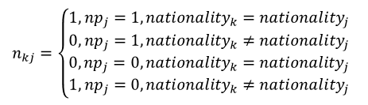
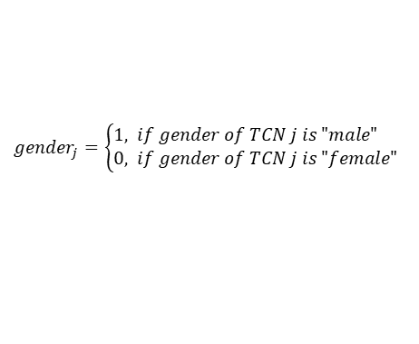
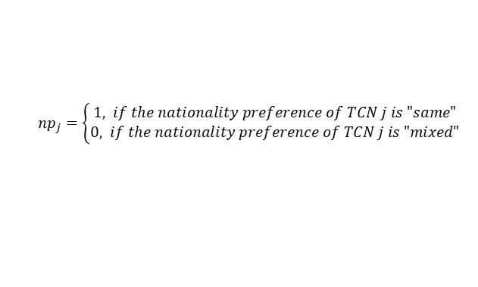
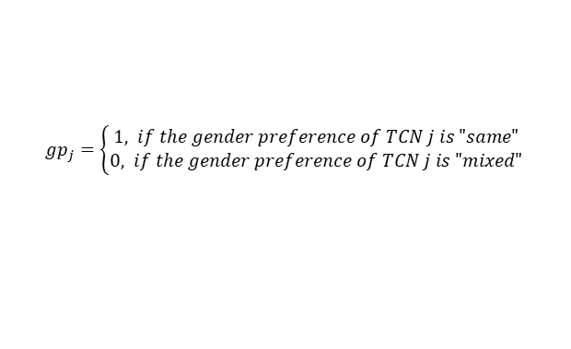
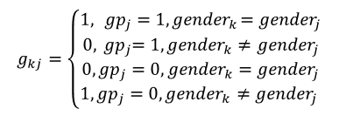
Functions
Utility function
The utility function assesses the individual preferences for each of the TCNs. In other words, it measures the degree of how well a Coalition fits to an agent. In LCC scenario, each TCN’s individual preferences consist of gender and nationality preferences.
$U_{j}^{i}=w_{1}∗G_{j}^{i}+w_{2}∗N_{j}^{i}$ $:Utility value for agent j in Coalition i, where i is index of Coalition and j is index of agent.$
$G_{j}^{i}=∑_{k=1,k≠j}^{n}g_{kj} :the number of times when gender preference of TCN j is met in Coalition i where n is the number of TCNs in Coalition i$
$$g_{kj}=\left\{\begin{aligned}\begin{aligned}\begin{aligned}1, { {gp}_{j}=1, gender}_{k}={gender}_{j}& \\ 0,{{ gp}_{j}=1, gender}_{k}≠{gender}_{j}\end{aligned} \\ 0,{{gp}_{j}=0, gender}_{k}={gender}_{j}\end{aligned} \\ 1, {{gp}_{j}=0, gender}_{k}≠{gender}_{j} \end{aligned}\right.$$
$$g_{kj}: 0, 1 whether TCN k satisfies the gender preference of TCN j$$
${gp}_{j}=\left\{\begin{aligned}1, &if the gender preference of TCN j is "same" \\ 0, if the gender preference of TCN j is "mixed"\end{aligned}\right.$
${gender}_{j}=\left\{\begin{aligned}1, &if gender of TCN j is "male" \\ 0, &if gender of TCN j is "female"\end{aligned}\right.$
$N_{j}^{i}=∑_{k=1,k≠j}^{n}n_{kj } :the number of times when nationality preference of TCN j is met in Coalition i$
$NATIONALITY=\left(N_{1}, N_{2}, . . . \left|NATIONALITY\right|\right) :A predefined list of nationalities$
${nationality}_{j}=\{0, 1, . . . (|NATIONALITY|−1)\} :index of the nationality of TCN j$
${np}_{j}=\left\{\begin{aligned}1, if the nationality preference of TCN j is "same" \\ 0, &if the nationality preference of TCN j is "mixed"\end{aligned}\right.$
$n_{kj}=\left\{\begin{aligned}\begin{aligned}\begin{aligned}1,{{np}_{j}=1, nationality}_{k}={nationality}_{j}& \\ 0,{{np}_{j}=1, nationality}_{k}≠{nationality}_{j}\end{aligned} \\ 0,{{np}_{j}=0, nationality}_{k}=nationality_{j}\end{aligned} \\ 1, {{np}_{j}=0, nationality}_{k}≠{nationality}_{j}\end{aligned}\right.$
$w_{1 },w_{2 }:weight factor 10 and 1, respectively$

Slide 11



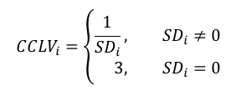




Functions
Coalition Value function
Coalition Course Level function
Coalition Value Function evaluates the suitability of a certain Coalition. In the LCC scenario, we design it as the integration of Utility Value and Coalition Course Level Value.
To assess how similar the course progress levels of the TCNs in the same Coalition, we design the Coalition Course Level Value function which calculates the standard deviation of the Course Progress Level score of all the TCNs, and then takes the multiplicative inverse. The reason for taking the multiplicative inverse is that a better Coalition should contain TCNs with similar CPL, which leads to a smaller standard deviation. In accordance with the Coalition Structure Value function design, we would like to maximize the Coalition Course Level Value.
$$CV_{i}=∑_{j=1}^{n}U_{j}^{i}∗ CCLV_{i}$$
Where:
$n:number of TCNs in the current Colition$
$$U_{j}^{i}:Utility value for agent j in Coalition i$$
$$SD_{i}= \sqrt{\frac{∑_{j=1}^{n}{({CPL}_{j}−{\sum_{h=1}^{n}{{CPL}_{h}}}/n)}^{2}}{n}} :Standard Deviation of Coalition i$$
$$CCLV_{i} :Coalition Course Level Value for Coalition i$$
Coalition Structure Value function
$$CCLV_{i}=\left\{\begin{aligned}\frac{1}{SD_{i}}, &SD_{i}≠0 \\ 3, &SD_{i}=0\end{aligned}\right.$$
Coalition Structure Value function is the overall evaluation value of a certain Coalition Structure. It is the sum of all the Coalition Values within the Coalition Structure. With the foundation of the previous functions, the Coalition Structure Value function assesses the quality of each Coalition Structure by taking the consideration of both how well the individual preferences of each TCN in the same Coalition are satisfied, and how similar the course progress levels of the TCNs in the same Coalition.
$$CCLV_{i} :Coalition Course Level Value for Coalition i$$
Where:
$$n:number of TCNs in Colition i$$
$${CPL}_{j}:the Course Progress Level of TCN j$$
$$CSV_{p}=∑_{i=1}^{m}CV_{i} :Value of the Coalition Structure p$$
Where $m:number of Coalitions in this Coalition Structure$

